Slide 1

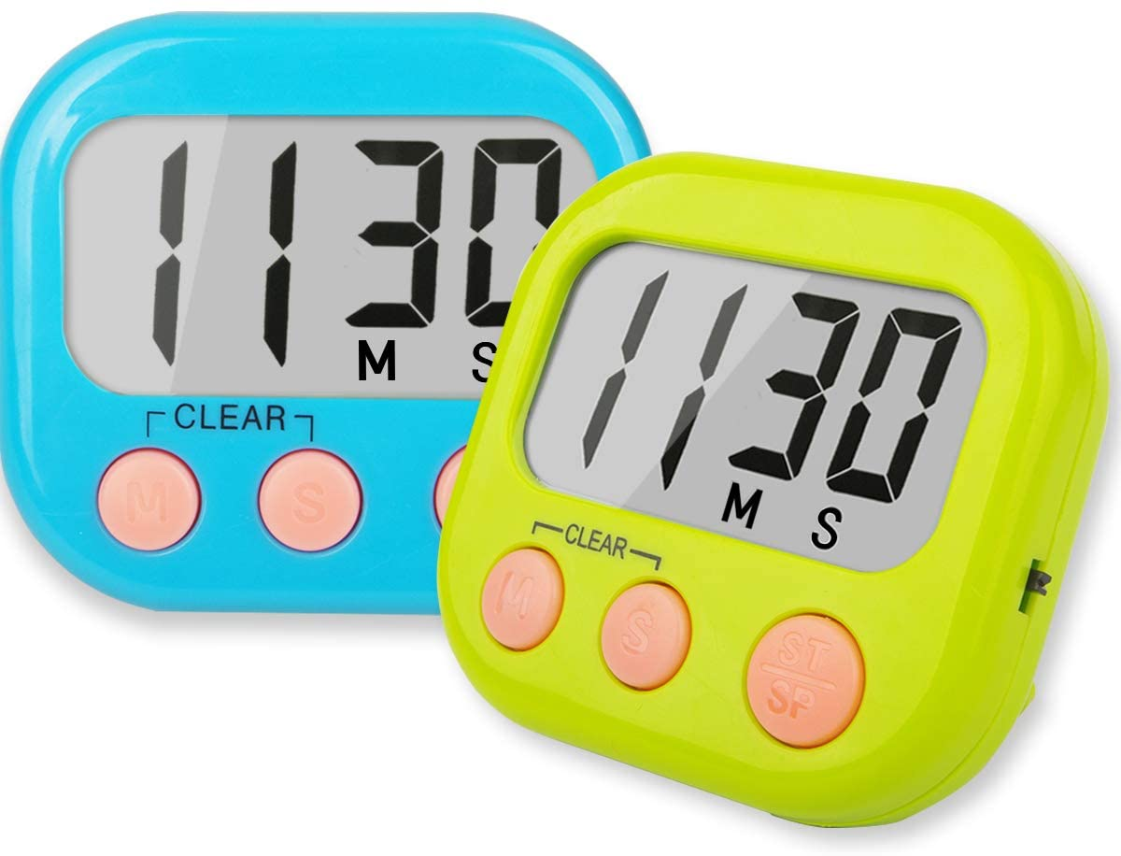
Latches, Flips Flops
&
Timers
Chapter 7
Week 1
Sumaiyah Zahid

Slide 2
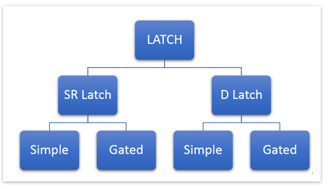
LATCHES
Memory storage device

Slide 3
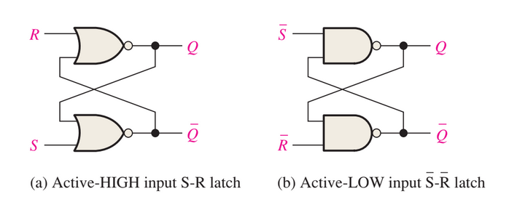
S-R (SET-RESET) Latch
SET means that the Q output is HIGH.
RESET means that the Q output is LOW.

Slide 4
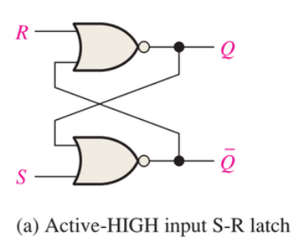
S-R (SET-RESET) Latch

Slide 5
S-R (SET-RESET) Latch
Case 1: S=1, R=0, Q=1, Q’=0
S=0, R=0, Q=1, Q’=0 (Memory)
Case 2: S=0, R=1, Q=0, Q’=1
S=0, R=0, Q=0, Q’=1 (Memory)
Case 3: S=1, R=1, Q=0, Q’=0 (Invalid )
S=0, R=0, Q=0, Q’=1
S=0, R=0, Q=1, Q’=0

Slide 6
S-R (SET-RESET) Latch
S | R | Q | Q’
0 | 0 | No Change | No Change
0 | 1 | 0 | 1
1 | 0 | 1 | 0
1 | 1 | Invalid | Invalid

Slide 7
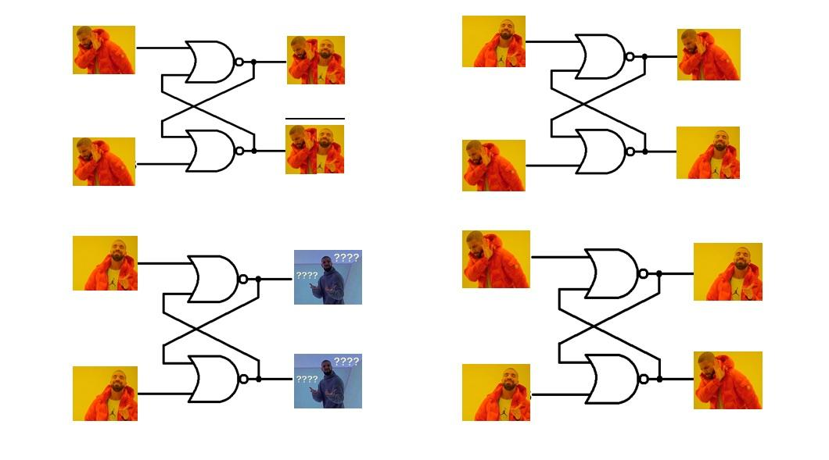

Slide 8
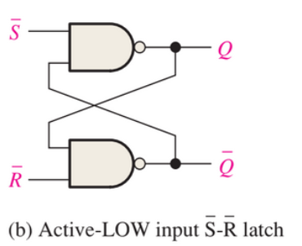
S-R (SET-RESET) Latch
S | R | Q | Q’
0 | 0 | Invalid | Invalid
0 | 1 | 1 | 0
1 | 0 | 0 | 1
1 | 1 | No Change | No Change

Slide 9
S-R (SET-RESET) Latch
Home Task:
Verify all the cases for Active Low SR Latch.
https://www.youtube.com/watch?v=kt8d3CYWGH4

Slide 10
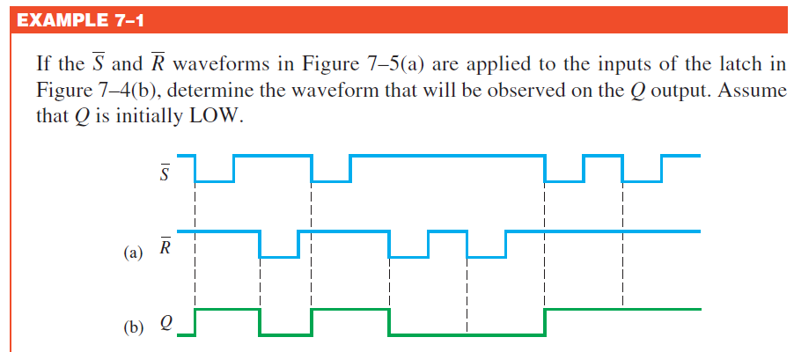
S-R (SET-RESET) Latch

Slide 11
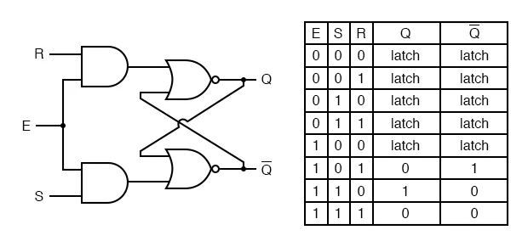
Gated SR Latch (Active High)

Slide 12
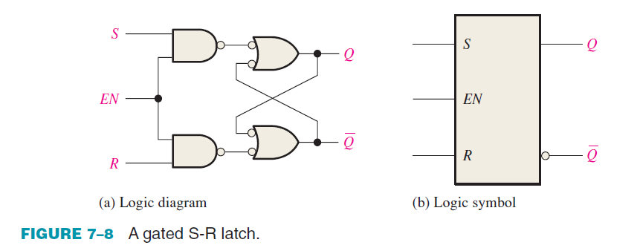
Gated SR Latch (Active High)

Slide 13
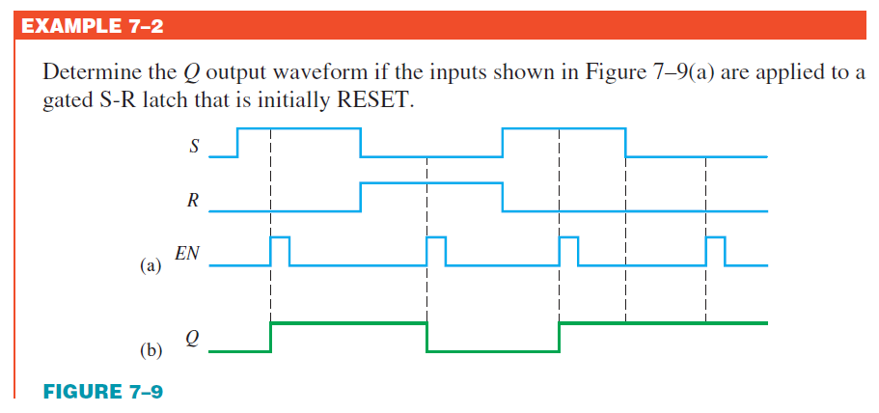
Gated SR Latch (Active High)

Slide 14
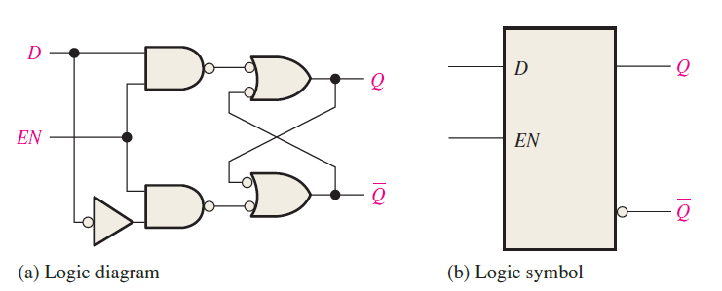
Gated D Latch
D = HIGH & EN = HIGH, the latch will set.
D = LOW & EN = HIGH, the latch will reset.
Stated another way, the output Q follows the input D when EN is HIGH.

Slide 15
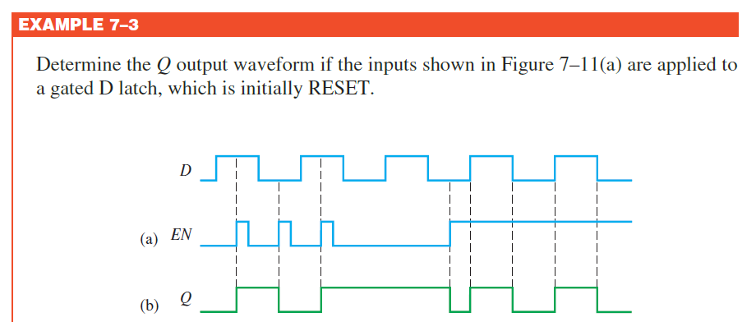
Gated D Latch

Slide 16

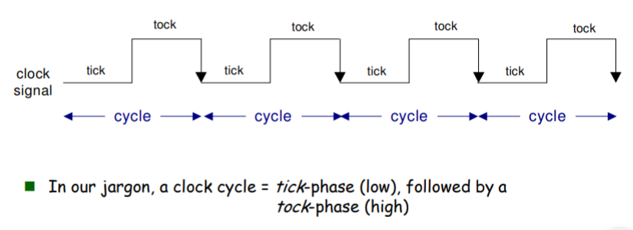
Clock
A periodic signal.

Slide 17
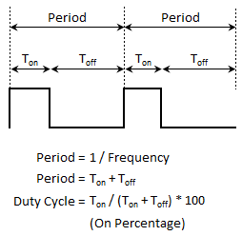
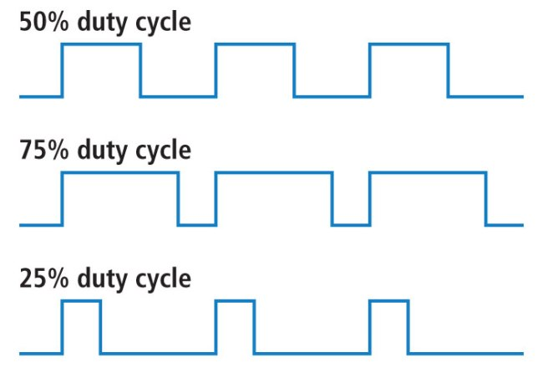
Clock

Slide 18
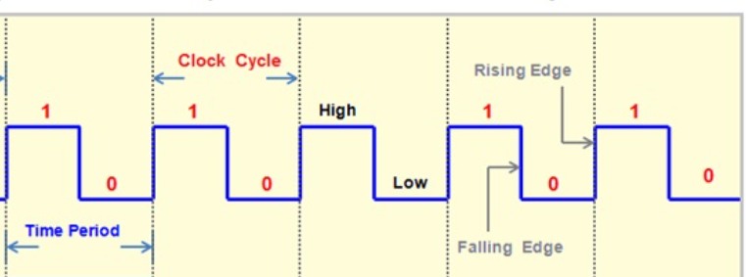
Clock

Slide 19
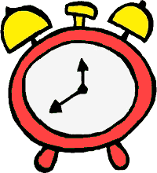
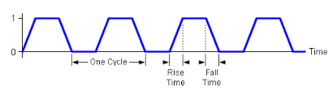
Clock

Slide 20
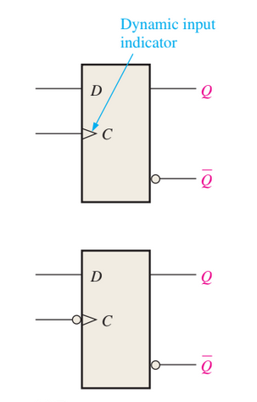
Flips Flops
Flip-flops are edge-triggered or edge-sensitive devices.
Output changes state only at a specified point (leading or trailing edge) on the triggering input called the clock (CLK).

Slide 21
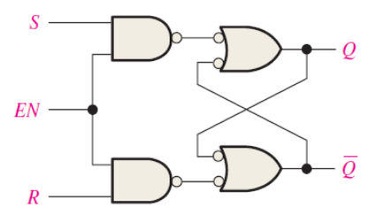
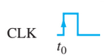
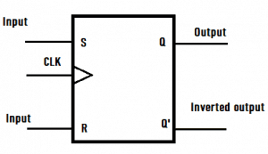
SR Flip Flop
CLK | S | R | Q | Q’
 | X | X | Q(n-1) | Q’(n-1)
 | 0 | 0 | Q’(n-1) | Q’(n-1)
 | 0 | 1 | 0 | 1
 | 1 | 0 | 1 | 0
 | 1 | 1 | Invalid | Invalid

Slide 22
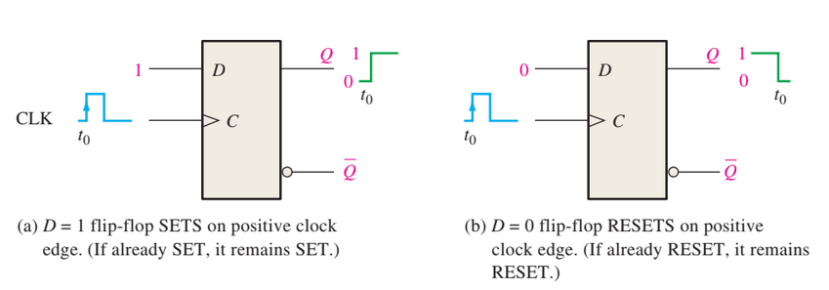
D Flip Flop

Slide 23
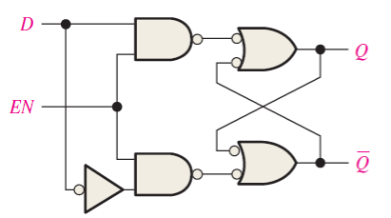
D Flip Flop
CLK | D | Q | Q’
 | X | Q(n-1) | Q’(n-1)
 | 1 | 1 | 0
 | 0 | 0 | 1

Slide 24
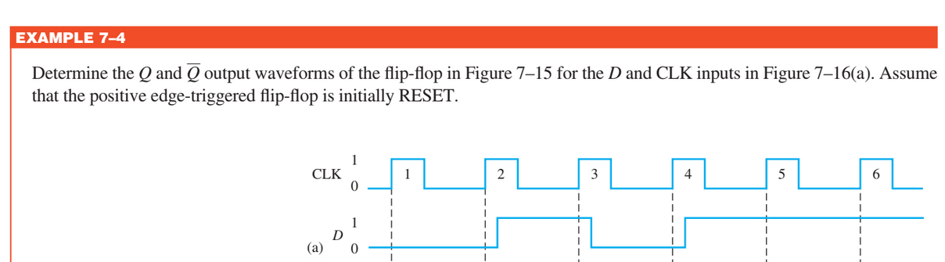
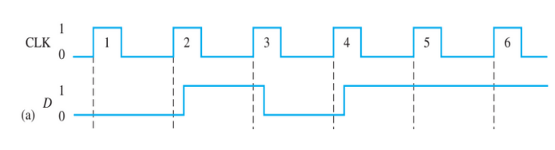
D Flip Flop

Slide 25

Limitations of D and SR Flip FLop
D has only single input.
SR flip flop has an invalid state.

Slide 26
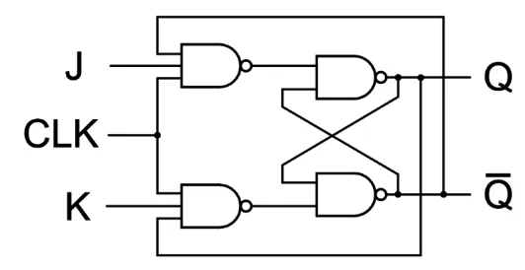
JK Flip FLop

Slide 27
JK Flip Flop
Case 1: CLK=0 (Memory)
Case 2: CLK=1, J=1, K=0, Q=1, Q’=0
Case 3: CLK=1, J=0, K=1, Q=0, Q’=1
Case 4: CLK=1, J=1, K=1,
Q(n)=0, Q’(n)=1, Q(n+1)=1, Q’(n+1)=0
Q(n)=1, Q’(n)=0, Q(n+1)=0, Q’(n+1)=1

Slide 28
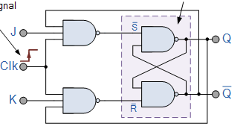
JK Flip Flop
CLK | J | K | Q | Q’
 | X | X | Q(n-1) | Q’(n-1)
 | 0 | 0 | Q’(n-1) | Q’(n-1)
 | 0 | 1 | 0 | 1
 | 1 | 0 | 1 | 0
 | 1 | 1 | Toggles | Toggles

Slide 29
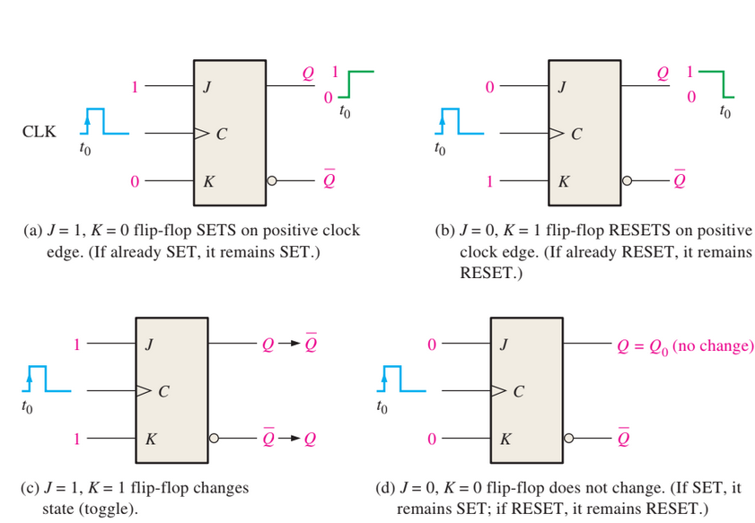
JK Flip Flops

Slide 30
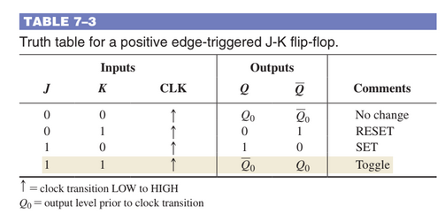
JK Flip Flops

Slide 31
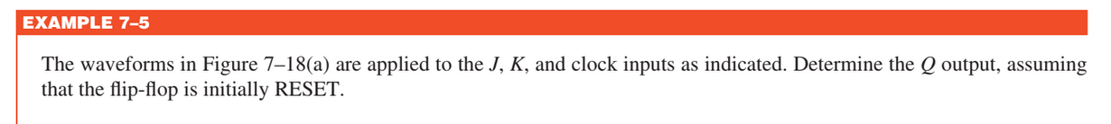
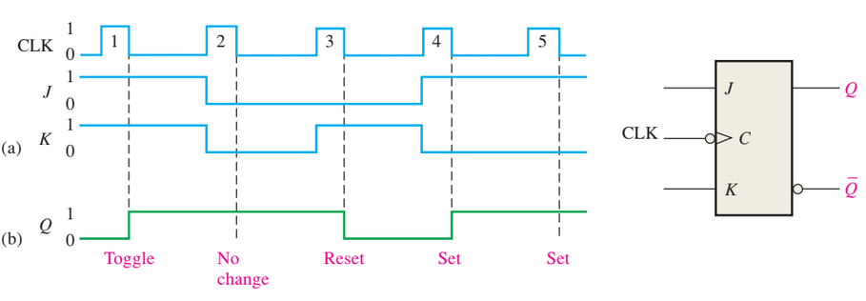
JK Flip Flop

Slide 32
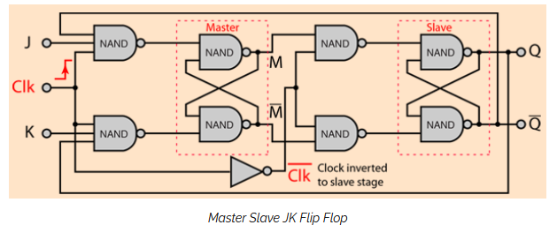
Master Slave JK Flip Flop

Slide 33
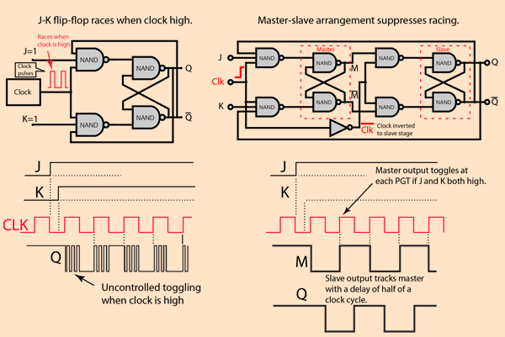
Master Slave JK Flip Flop

Slide 34
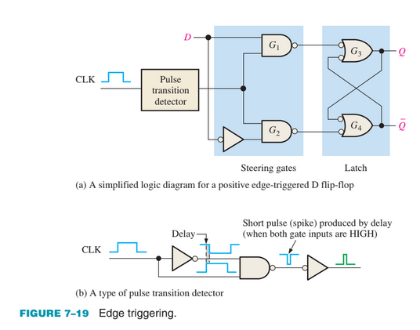
Edge Triggering
D Flip FLop

Slide 35
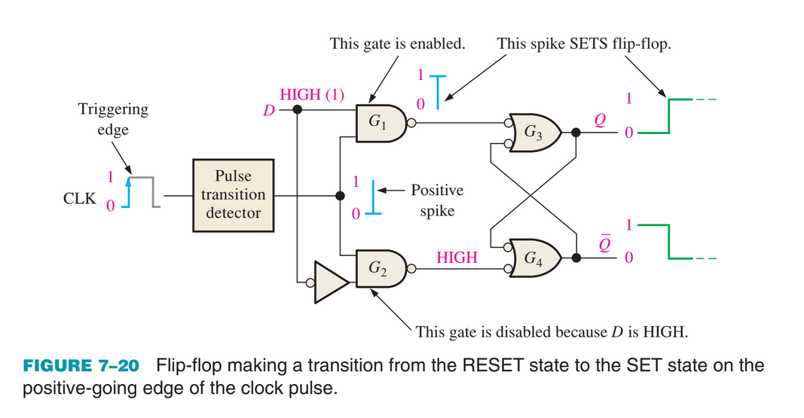
Edge Triggered - D Flip FLop

Slide 36
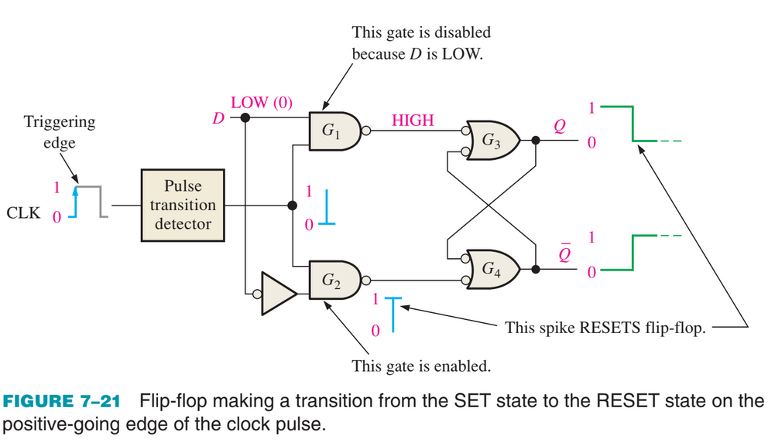
Edge Triggered - D Flip FLop

Slide 37
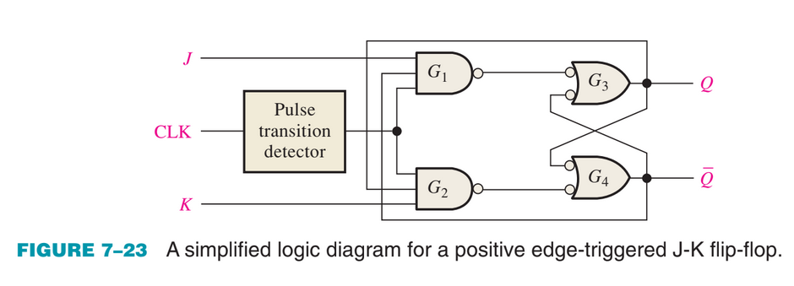
Edge Triggered - JK Flip FLop

Slide 38
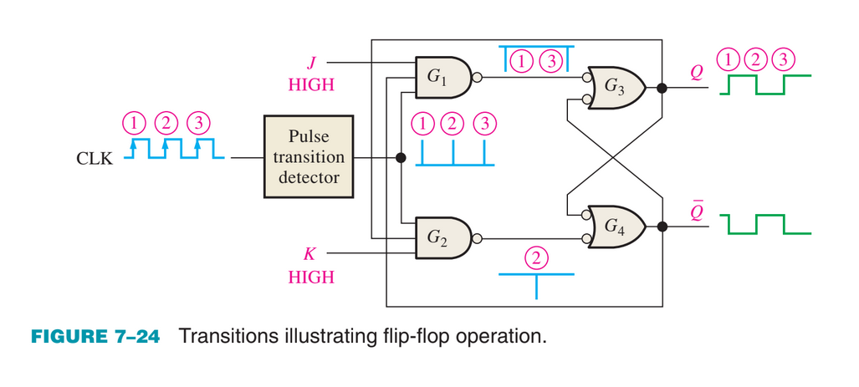
Edge Triggered - JK Flip FLop
A J-K flip-flop connected for toggle operation is sometimes called a T flip-flop.

Slide 39
Synchronous Vs Asynchronous Inputs
D and J-K inputs are called synchronous inputs, because the data transferring is synchronised with the clock.
Asynchronous inputs affect the state of the flip-flop independent of the clock.
Preset (PRE) and Clear (CLR)
OR
Direct set (SD) and Direct reset (RD)

Slide 40
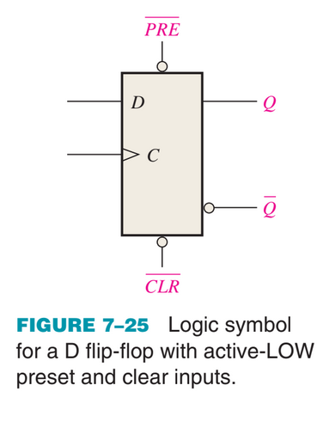
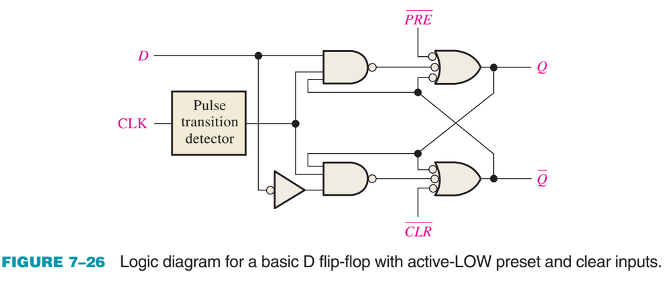
Synchronous Vs Asynchronous Inputs

Slide 41
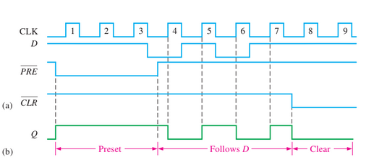
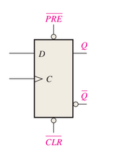
Synchronous Vs Asynchronous Inputs
For the positive edge-triggered D flip-flop with preset and clear inputs in Figure, determine the Q output for the inputs shown in the timing diagram in part (a) if Q is initially LOW.

Slide 42
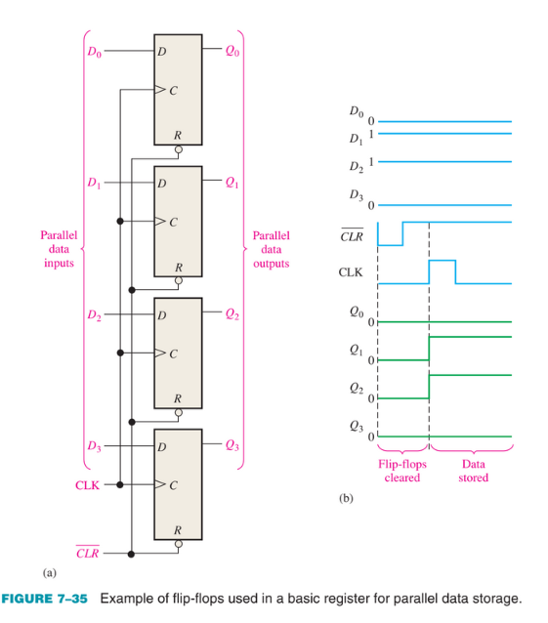
Flip Flop Applications
Parallel Data Storage
This group of four flip-flops is an example of a basic register used for data storage.

Slide 43
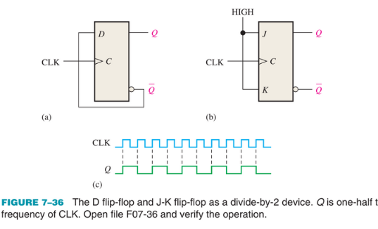
Flip Flop Applications
Frequency Division
A single flip-flop can be applied as a divide-by-2 device.

Slide 44
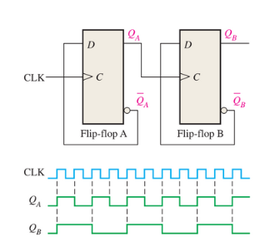
Flip Flop Applications
Frequency Division
Further division of a clock frequency can be achieved by using the output of one flip-flop as the clock input to a second flip-flop.

Slide 45
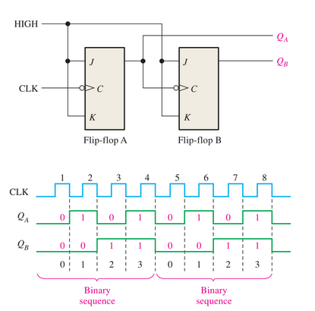
Flip Flop Applications
Counters
J-K flip-flops used to generate a binary count sequence (00,01,10,11).
Two repetitions are shown.

Slide 46
Home TAsk
Design a counter which can count from 0 through 15.
Reading Task : 7–3 Flip-Flop Operating Characteristics

Slide 47
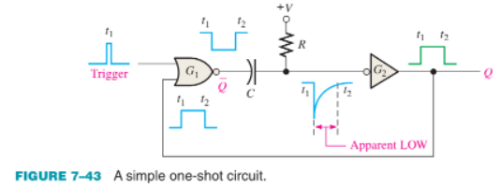
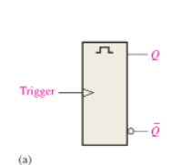
One Shots
Also known as a monostable multivibrator is a device with only one stable state.
The time that the device stays in its unstable state determines the pulse width of its output.

Slide 48
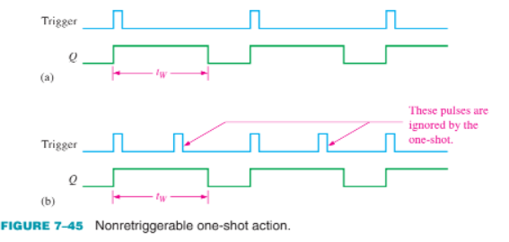
One Shots

Slide 49

One Shots

Slide 50

The Astable Multivibrator
Has no stable states
It changes back and forth (oscillates) between two unstable states without any external triggering.

Slide 51
The Astable Multivibrator
The resulting output is typically a square wave that is used as a clock signal in many logic circuits.
Also known as pulse oscillators.

Slide 52

555 Timer

Slide 53

555 Timer

